Slide 1

Narratives of China in the US media
Analysis of NYT articles
Introduction to Data Science Final Project
Kathryn Zickuhr, Yuqi Liao

Slide 2
Outline
Project Goals
Background
Data Overview
Word Association; Word Frequency; Word Cloud
Bigrams & Trigrams
Clustering
Topic Modeling
Lessons for the Future
Resources

Slide 3
Project Goals
How various narratives about China have changed over time
Examine whether the topics the American media has focused on in its coverage of China changed from 1990 to 2000
What the characteristics of articles in this time span are
Use lead paragraph of NYT articles

Slide 4
Major Events
1989: Tiananmen Square
1991: China joins Asia-Pacific Economic Cooperation
1992: Deng Xiaoping accelerates market reforms
1992: China ratifies the Nuclear Non-Proliferation Treaty
1994: China Starts the "Three Gorges Dam" Project
1995: Taiwanese president visits U.S.
1996: 3rd Taiwan Strait Crisis
1997: Hong Kong returns to Chinese Rule
1998: Clinton visits China
1999: Bombing of the Chinese Embassy in Belgrade
1999: China Seeks Entry to WTO

Slide 5
Download & Pre-Process Data
Used python to retrieve articles mentioning China from the New York Times Article API (JSON -> TSV -> CSV)
Method: https://github.com/casmlab/get-nytimes-articles
Next, pre-processed the text of the articles in Python and R (lowercase, removed #s, removed stopwords, stemmed, etc.)
Converted to a term document matrix
Notes:
Since we pulled in all articles mentioning China, we got a lot of pieces that weren’t strictly about US/China relations--a lot of articles about restaurants, Chinatown in NYC, etc., as well as the arts, books, sports, and other topics.

Slide 6
Data Overview: Word Associations
> findAssocs(tdm, "tiananmen", 0.2)
tiananmen
squar 0.63
massacr 0.29
crackdown 0.26
democraci 0.22
demonstr 0.22
prodemocraci 0.22

Slide 7
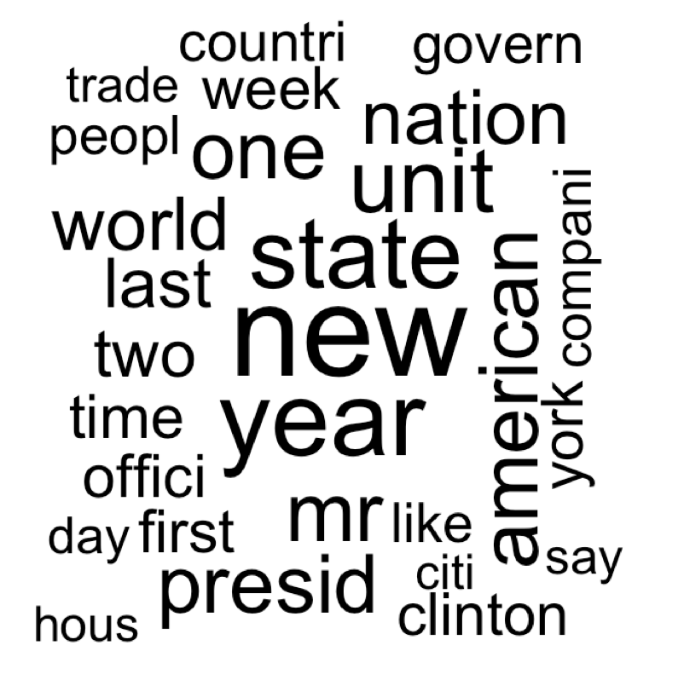
Data Overview: Word Cloud

Slide 8
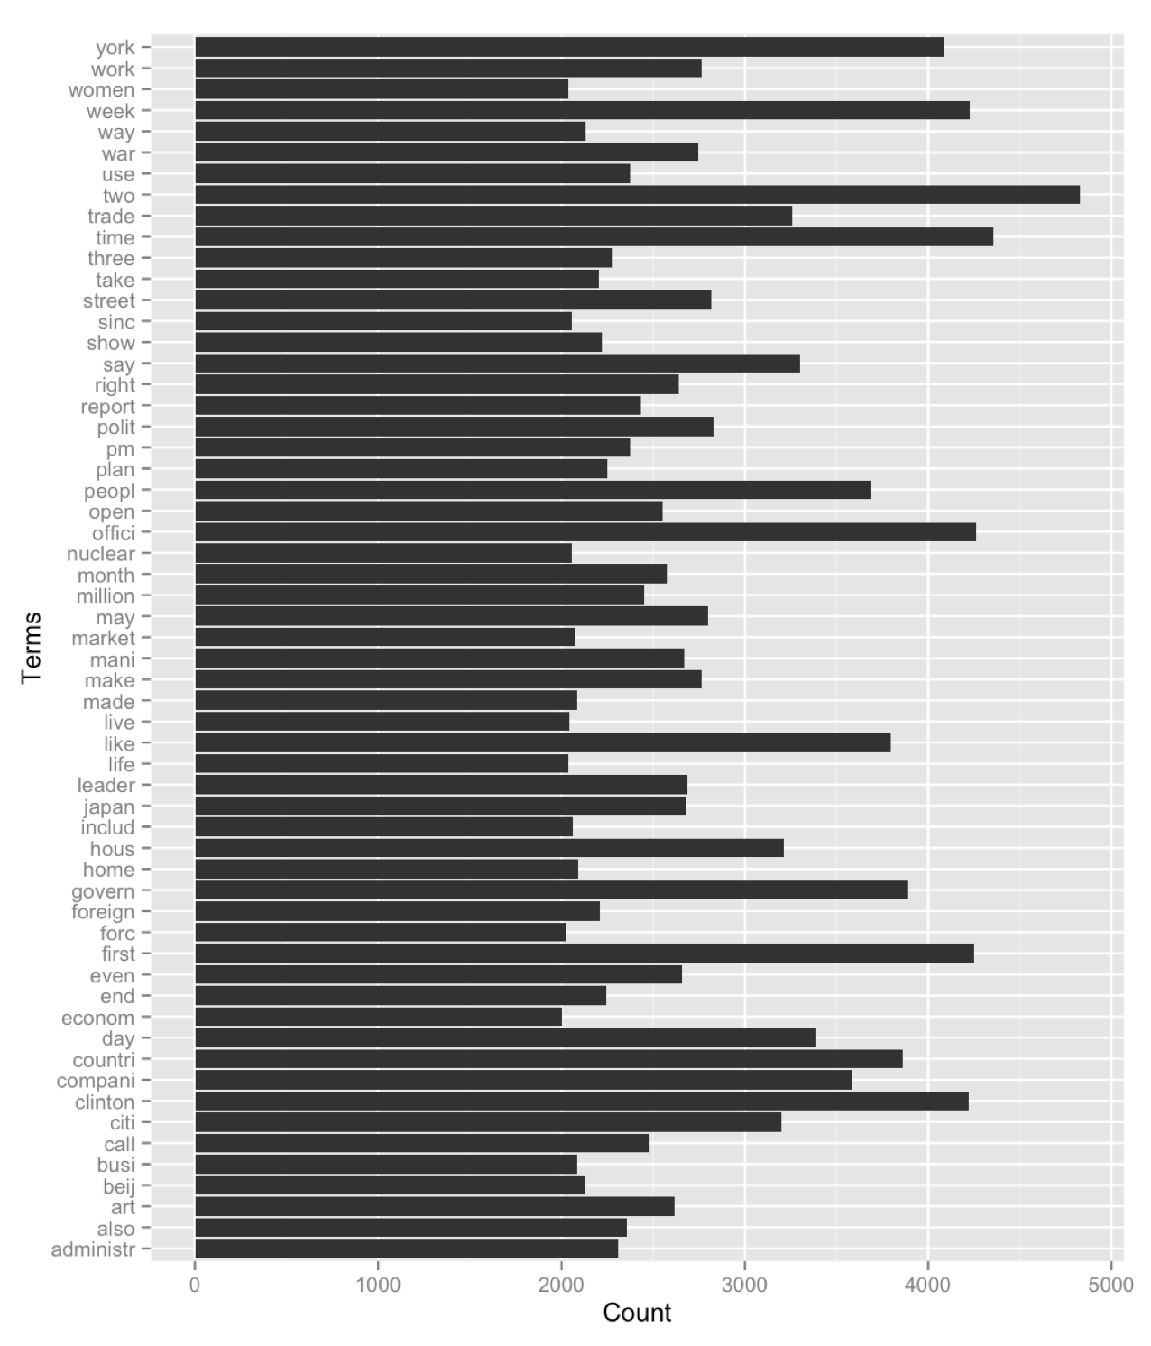
Data Overview:
Frequent words (most freq removed)

Slide 10
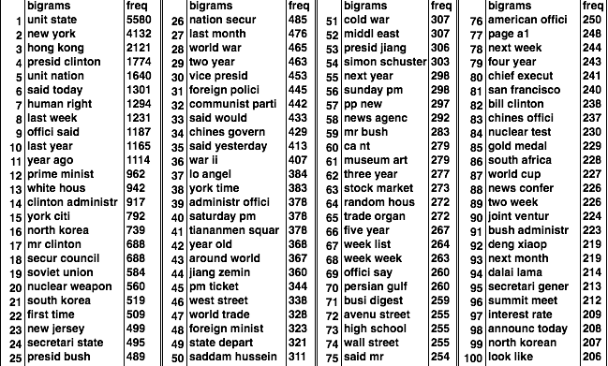
Data Overview: Top 100 bigrams
Notes:
reflects presidency changes: clinton, bush, jiang ze min, deng xiao ping
human right
hong kong
nuclear
market

Slide 11
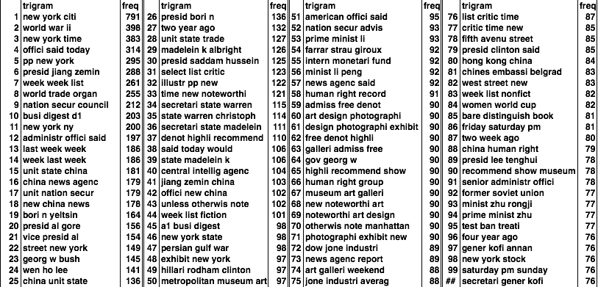
Data Overview: Top 100 trigrams

Slide 12
One approach: Clustering
Based on methods in R and Data Mining: Examples and Case Studies (@RDataMining)
One potential disadvantage of K-means clustering is that it requires us to pre-specify the number of clusters K
Hierarchical clustering has an added advantage over K-means clustering in that it results in an attractive tree-based representation of the observations, called a dendrogram
Notes:
unsupervised learning: We are not interested in prediction, because we do not have an associated response variable Y . Rather, the goal is to discover interesting things about the measurements on X1, X2, . . . , Xp
two particular types of unsupervised learning: principal components analysis, a tool used for data visualization or data pre-processing before supervised techniques are applied, and clustering, a broad class of methods for discovering unknown subgroups in data.

Slide 13
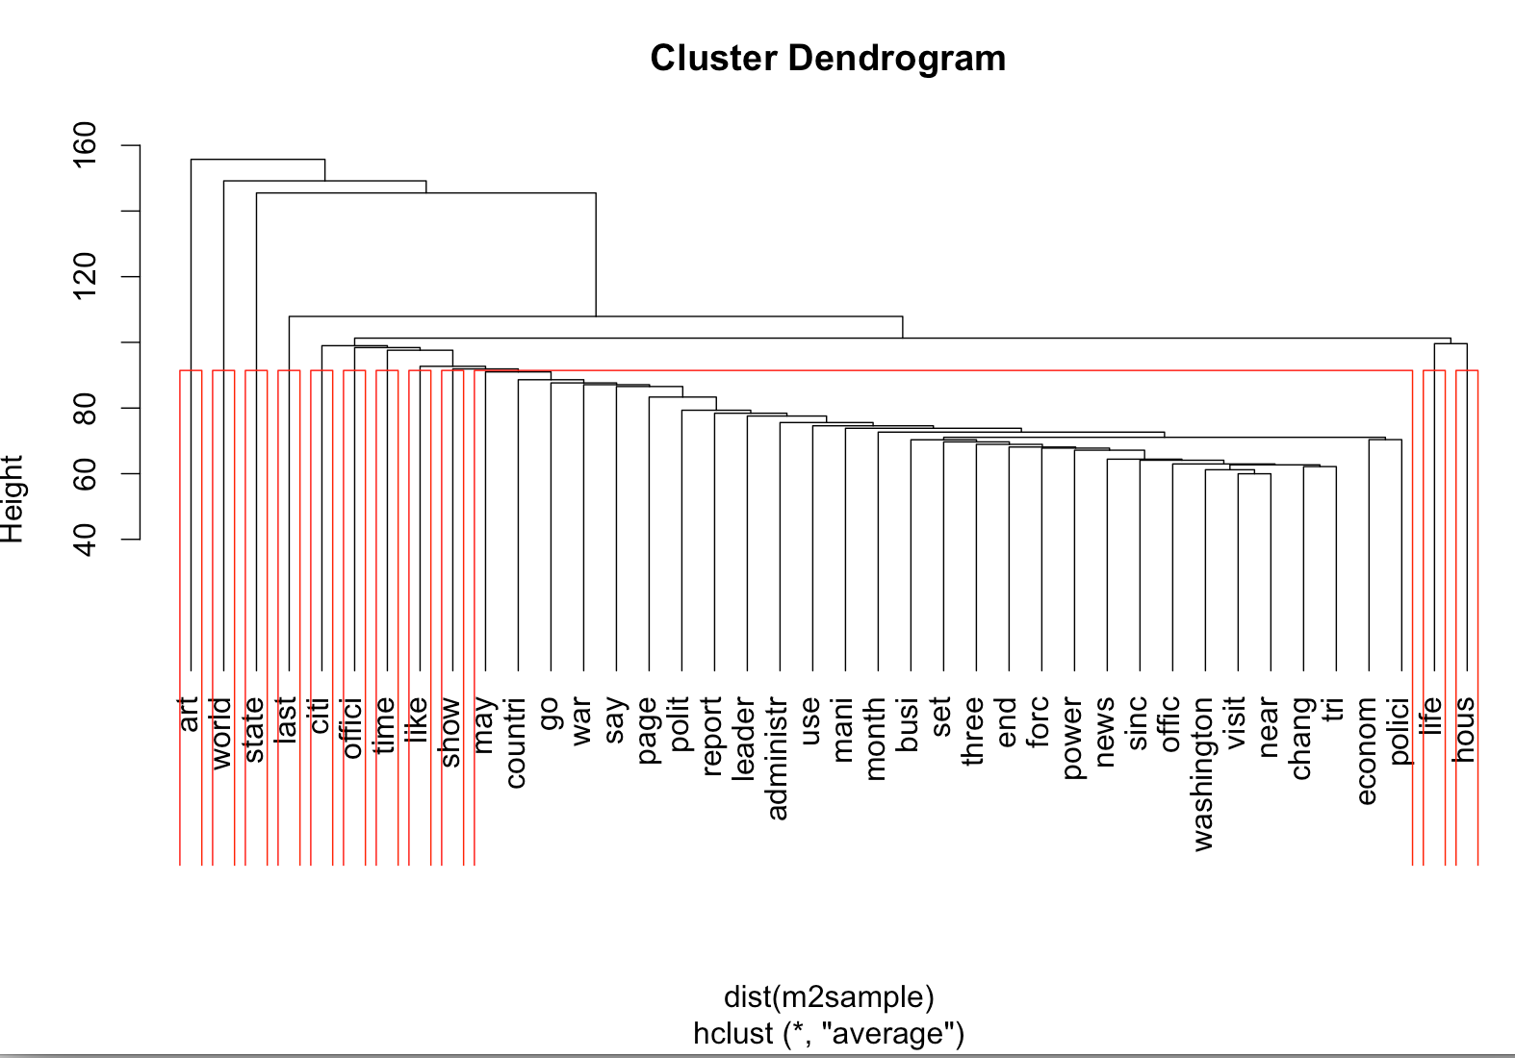

Slide 14
Example: 6 clusters
1: new street art york world work open state mr us
2: new year state presid nation week mr one hous two
3: year one world last american mr two like new nation
4: unit state nation american world year offici countri trade new
5: presid clinton mr american trade administr hous offici state year
6: new york year citi time art one street mr last

Slide 15
Example: 15 clusters
1: art new street york show work includ time citi american
2: presid clinton mr hous trade state administr polici american nation
3: one world mr like new peopl nation govern say day
4: unit state nation world american offici countri year new trade
5: japan world war american countri year trade state unit first
6: new york citi time year mr one compani street state
7: week mr life last one new hous world time year
8: last week year month mr one world new govern time
9: american trade offici state unit administr world clinton nation compani
10: year last new one world two ago first mr time
11: new year state week two american compani york last one
12: two one year mr first world day new nation week
13: year one ago mr world like die time nation first
14: street new art york work world open state show includ
15: new presid nation state year offici clinton govern unit citi

Slide 16
One approach: Topic modeling (LDA)
Based on methods in R and Data Mining: Examples and Case Studies (@RDataMining)
Latent Dirichlet Allocation (LDA)
“Bag of words” model
Bayes classifier assigns words to topics
Still choose K topics you think the data will fall into
Notes:
Uses Bayes theorem to classify words to different topics based on the relative frequency of words in each article (document)

Slide 17
Topic modeling (LDA): 6 topics
Topic 1 Topic 2 Topic 3 Topic 4 Topic 5 Topic 6
[1,] "one" "compani" "world" "presid" "new" "new"
[2,] "like" "year" "women" "unit" "art" "citi"
[3,] "year" "market" "team" "state" "pm" "offici"
[4,] "time" "hong" "book" "nation" "york" "year"
[5,] "mr" "kong" "week" "clinton" "street" "nation"
[6,] "peopl" "million" "new" "mr" "museum" "say"
[7,] "day" "percent" "state" "american" "music" "feder"
[8,] "even" "new" "game" "offici" "avenu" "hous"
[9,] "world" "billion" "life" "leader" "sunday" "peopl"
[10,] "look" "trade" "unit" "govern" "center" "two"

Slide 18
Topic modeling (LDA): 15 topics
1: company, market, percent, year, million, billion, stock, new, industry, economy
2: leader, party, govern, mr, polit, beijing, communist, year, right, human
3: state, unit, trade, clinton, american, nuclear, president, taiwan, korea, administ
4: new, york, die, mr, year, university, school, home, dr, hospital
5: book, year, story, novel, one, world, life, new, culture, history
6: week, book, life, new, illustr, house, woman, list, york, age
7: film, art, new, show, mr, movie, work, design, museum, year
8: unit, nation, war, president, state, ira1, russia, military, council, soviet
9: hong, kong, city, people, year, immigr, new, last, two, british
10: one, world, like, people, say, ever, time, mr, year, get
11: president, mr, clinton, office, house, state, american, nation, white, administration
12: team, world, women, game, state, unit, olympic, men, first, play
13: one, like, street, restaurant, day, city, house, room, year, new
14: new, president, city, house, republican, court, senate, york, clinton
15: pm, new, art, street, museum, music, ticket, saturday, sunday, york

Slide 19
Topic modeling: 15 topics (summary)
1: Stock market & economy
2: Human rights, Beijing
3: Taiwan, trade, nuclear
4: New York, university, hospital
5: Books (novels, history, culture)
6: New York, books
7: Film, design, museums
8: Iraq, Russia, military, council, Soviet, war
9: Hong Kong, British, year, last
10: one, world, like, people, say, ever, time, year, get (?)
11: Clinton, House
12: Sports
13: Restaurants
14: Clinton, Senate, Republicans
15: New York weekend cultural activities

Slide 20
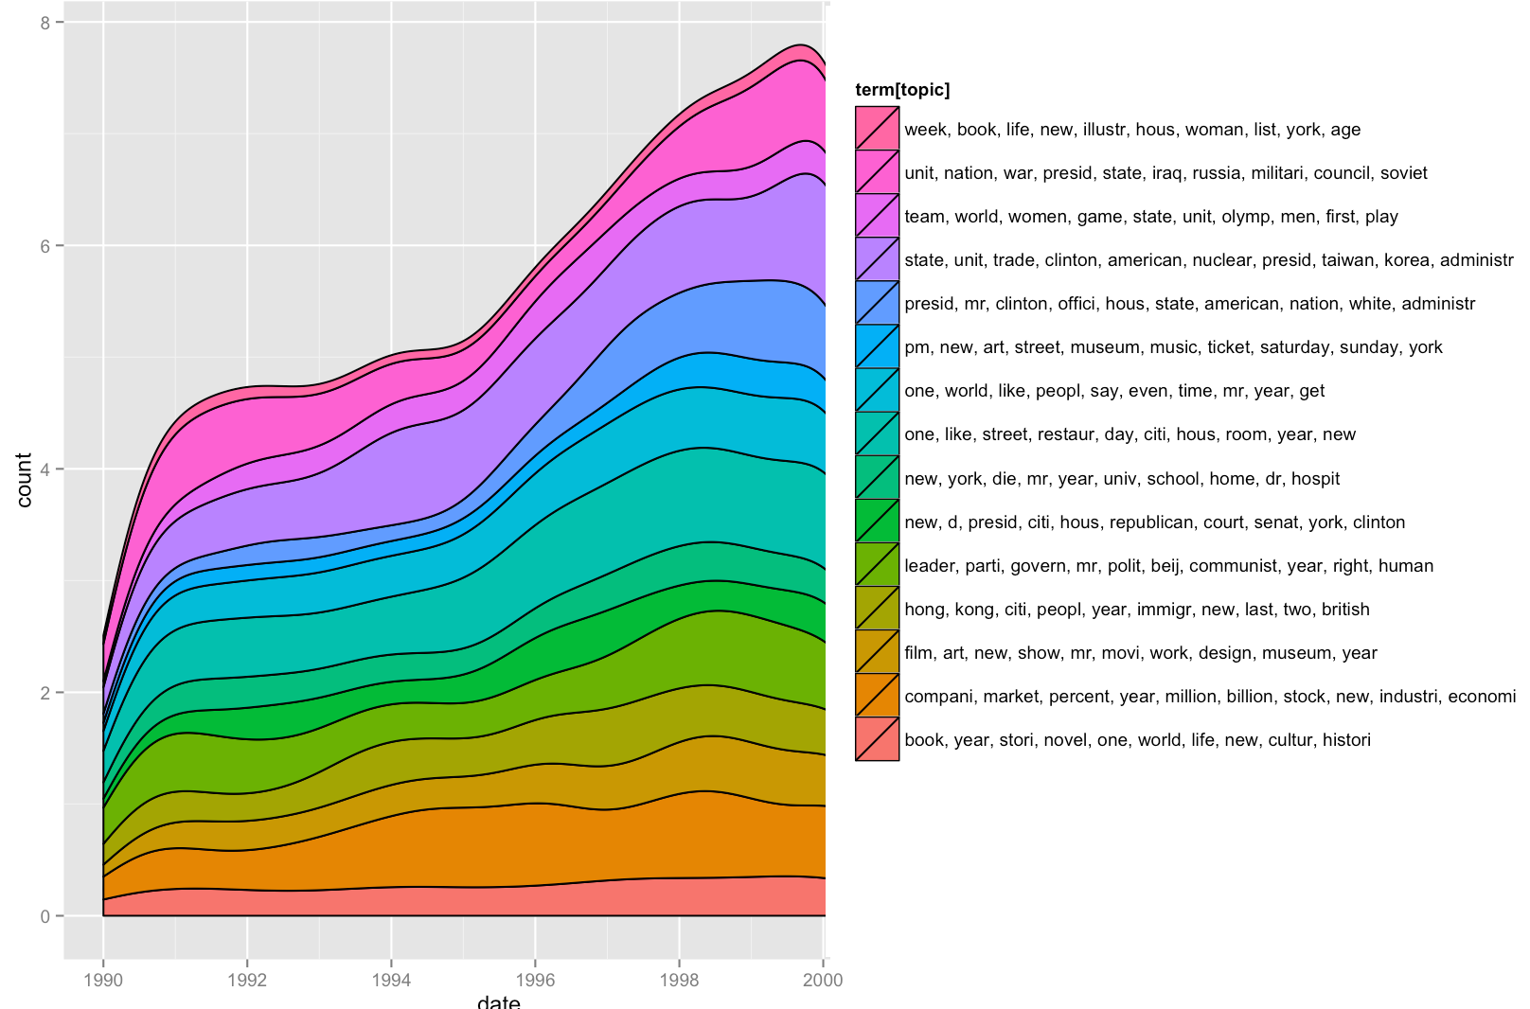
Notes:
Increase in coverage overall (though may be increase in all news)

Slide 21
Major Events
1989: Tiananmen Square
1991: China joins Asia-Pacific Economic Cooperation
1992: Deng Xiaoping accelerates market reforms
1992: China ratifies the Nuclear Non-Proliferation Treaty
1994: China Starts the "Three Gorges Dam" Project
1995: Taiwanese president visits U.S.
1996: 3rd Taiwan Strait Crisis
1997: Hong Kong returns to Chinese Rule
1998: Clinton visits China
1999: Bombing of the Chinese Embassy in Belgrade
1999: China Seeks Entry to WTO

Slide 22
Future approaches
If interest is “hard news”:
Filter articles to focus on international news/foreign desk
Filter on certain words (+trade, -food)
Start with groups of words per topic
Run analysis over different number of clusters to see which minimizes residuals

Slide 23
Resources
State Department: Chronology of U.S.-China Relations, 1784-2000
https://history.state.gov/countries/issues/china-us-relations
R and Data Mining: Examples and Case Studies
An Introduction to Statistical Learning with Applications in R

